Slide 1
Building blocks of HTML
HTml KIN Kin CHEEJO Se Mil k bna h ?

Slide 2
An HTML document consist of its basic building blocks which are:
Tags : An HTML tag surrounds the content and apply meaning to it. It is written between < and > brackets.
Attribute: An attribute in HTML provides extra information about the element, and it is applied within the start tag. An HTML attribute contains two fields: name & value.

Slide 3
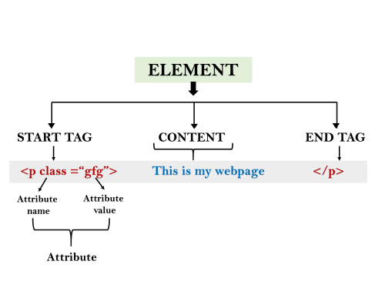
Syntax <tag_name attribute_name= " attr_value"> content </ tag_name >

